Slide 1
Green University of Bangladesh
Department of Computer Science & Engineering
Subject: Algorithms
Course Code:CSE-205
Presentation topic : Breadth First Search (BFS)
Submitted To:
Name :Jargis Ahmed
Designation : Lecturer
Department : CSE
Green University of Bangladesh
Submitted by :
Name : Jakirul Islam
ID : 193002101
Section :DC(193)
Department : CSE

Slide 2
Outline
What is BFS
Graph Variations
Application of BFS

Slide 3
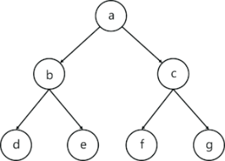
What is Breadth First Search (BFS)?

Slide 4
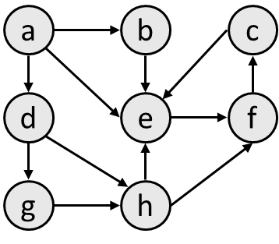
Breadth First Search (BFS)

Slide 5
Application of BFS
Broadcasting in Network
In Garbage Collection
Peer to Peer Networks
Social Networking Websites

Slide 6
Thank you

